Slide 1



Rochester
General
Hospital
PGY-1 Pharmacy Residency Program
Beth Sutton Burke, Pharm.D., BCACP, CDCES, BC-ADM
Residency Program Director
Accredited by the American Society of Health System Pharmacists
Notes:
Two years ago this month I stood in front of an audience just like you.
Considering or knowing they want a residency
Looking at programs that will build upon what they learned in school to make them;
Strong clinical pharmacists
PGY2
What I didn’t know two years ago is that someone in THAT audience would be one of my next residents.
Let me share with you what I told Diane, and let me tell you some of Diane’s story as our resident.

Slide 2








Rochester General Hospital
528 Beds
36
Largest hospital in Rochester Regional Health System
Pharmacists with Board Certification, Residency Training, Fellowship, or Advanced Degree
45 Pharmacists
2
10 Specialists,
33 Clinical Pharmacists
SJF Pharmacy Professors
RGH Pharmacy Residencies:
PGY1 Pharmacy
PGY2 Ambulatory Care

Slide 3









Where Do RGH Residents
Come From?

Slide 4
RGH PGY-1 Residency Rotations
Required
Longitudinal
Elective (pick 3)
  Antimicrobial Stewardship/ID¹
  Critical Care¹
  Staffing Core¹
  Ambulatory Care¹
  Internal Medicine & Surgery¹
  Internal Medicine II¹
  Orientation²
  Medication Safety
  Pharmacokinetics
  Boot Camp
  Staffing Longitudinal
  Teaching Certificate (optional)
  Research Projects (2)
  Pharmacy Management Topic Discussions Group
  Presentation Skills
  Pharmacy Administration
  Advanced (Adv.) Critical Care²
  Adv. Antimicrobial Stewardship/ID²
  Adv. Pharmacy Administration²
  Adv. Internal Medicine²
  Cardiology Inpt/Outpt²
  Emergency Medicine²
  Geriatrics²
  Pediatrics²
  Precepting²
  Oncology²
  Specialty Pharmacy²
¹5 week duration, ²4-week duration

Slide 5
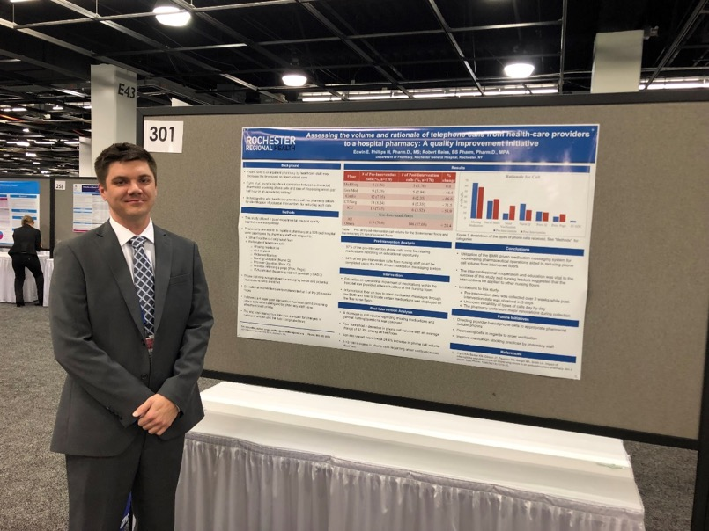
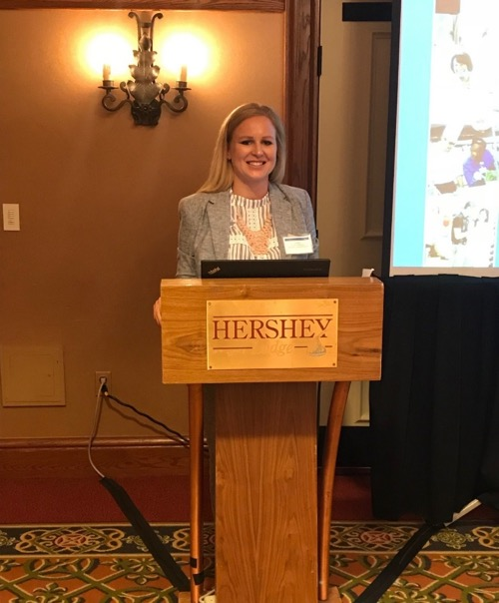
Projects – Two Required
Poster at ASHP (December)
Presentation at NYSCHP (April)

Slide 6
Quotes From Our Resident Evaluations
Became a more well-rounded pharmacist
Learned the “why” behind my answers
Improved my presentation skills
Became more efficient
Learned about things that I never knew I needed to know
Enjoyed precepting students
The strength of this program is the preceptors

Slide 7

Follow us on Instagram!
@rghpharmacyresidency

Slide 8


Ready to Apply to RGH?
GREAT!!
Application deadline
Screening interviews (Zoom)
Interviews
January 4
January
Jan-Feb
Questions? residency.rochesterregional.org/rgh-pharm/
Email: beth.suttonburke@rochesterregional.org

